Slide 1
Automatic SQL-to-NoSQL Schema
Transformation
Manan Pandya
1911033 A2
Authors : Chao-Hsien Lee and Yu-Lin Zheng

Slide 2
Introduction
With the explosive growth of huge data, and the less flexibility of SQL databases to from parallel processing, cloud computing adopts NoSQL database as it supports horizontal scaling to handle big data.
Therefore, how to convert existing SQL data into NoSQL database has become and emerging and necessary issue.
In this paper we will try to automate SQL to NoSQL schema transformation mechanism over the MySQL and HBase databases.
Based on the experimental results the proposed mechanism is able to improve about 47% access performance.

Slide 3
What are SQL databases?
In order to reduce the redundancy among the data, traditional relational databases organize data into more than one or more tables. A table comprises of rows and columns. Each row has a unique key by which it is represented i.e. Primary Key. Columns in a row represents the attribute values of each instance.
Once the database normalization is finished i.e. data is organized into tables, the data can be accessed using SQL (structured query language).
We can utilize the JOIN operation to query data across tables simultaneously
Hence relational databases are called as SQL databases.

Slide 4
What are NoSQL databases?
NoSQL databases provide different mechanisms for storing unstructured data, like column based, key-value based, document based and graph based.
The column based NoSQL databases are also made up of tables just like a traditional relational database.
Since NoSQL databases support horizontal scaling, i.e. processing several instances on different servers simultaneously.
Because of this scaling characteristic, the column based NoSQL databases store data into a big table.

Slide 5
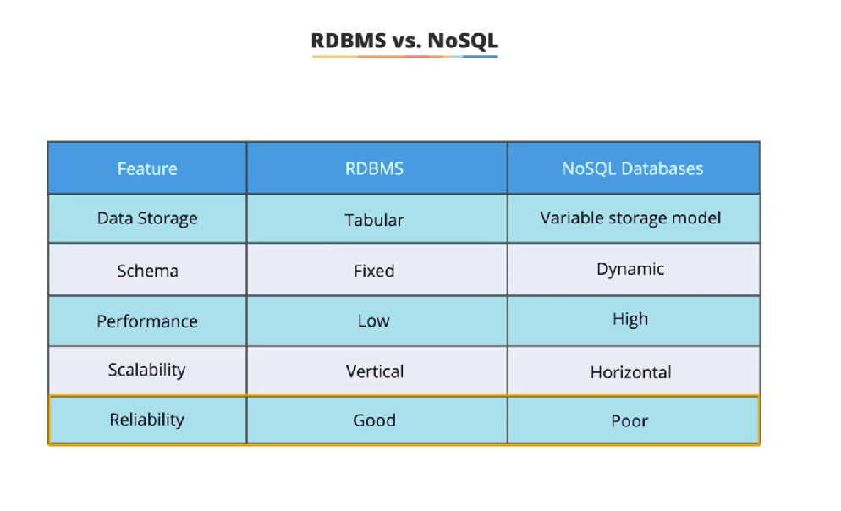

Slide 6
SQL to NoSQL Schema Transformation
Using the NoSQL’s DDI design principles to aggregate related tables into a big table then automatically select the most suitable key, which is called row key. A row key in a column based NoSQL database is used to uniquely identify each row.
There are two basic choices for table design schema : tall-narrow and flat-wide. Tall-narrow design patterns means a table with few columns and many rows. Since HBase can only split at row boundaries, we will be using a tall-narrow pattern irrespective of the design pattern used in SQL database.

Slide 7
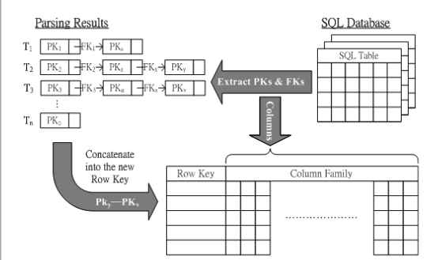
How to make the row key from the SQL database
MySQL stores all the table schemas in one special table called “information_schema”, thus, from that table we can get the primary key (pk) and foreign key (fk) and let each table’s pk and fk be the head of one linked list. If the foreign key exists then concatenate the related tables pk and fk into the corresponding linked list. The list with the highest cardinality will be the combination of all the primary keys with the longest chained length.

Slide 8
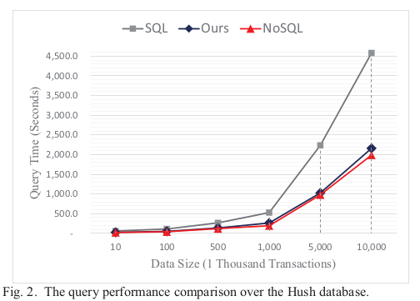
Performance Evaluation
The data size is configured from 10 thousand transactions to 10 million transaction. When the data size increases, three mechanisms require more time to complete the data query. The SQL versions require much more time than the 2 mechanism while the data size is 10 million transactions.

Slide 9
Conclusion
Although most of the web network services are still based on the SQL database, NoSQL provides better scalability and performance to handle big data. In order to reproduce the migration overhead from SQL to NoSQL, it is motivated in this paper to provide an automatic SQL-to-NoSQL schema transformation mechanism.
Based on the experimented results, the proposed mechanism can determine one suitable row key and then improve 47% access performance.

Slide 10
Strategy of Implementation
Implementation : Represent SQL database as HBase database which is a NoSQL database
Strategy : To perform SELECT and JOIN operations on the MySQL database tables to form the big table and also get the primary key, foreign key linked list to get the row key.

Slide 11
References
S. Lombardo, E. Di Nitto, and D. Ardagna, "Issues in Handling Complex Data Structures with NoSQL Databases," Proceedings of the 14th International Symposium on Symbolic and Numeric Algorithms for Scientific Computing (SYNASC), pp. 443-448, Sept. 2012
Yishan Li and S. Manoharan, "A performance comparison of SQL and NoSQL databases," Proceedings of IEEE Pacific Rim Conference on Communications, Computers and Signal Processing (PACRIM), pp. 15- 19, Aug. 2013.
W. Naheman and Jianxin Wei, "Review of NoSQL databases and performance testing on HBase," Proceedings of International Conference on Mechatronic Sciences, Electric Engineering and Computer (MEC), pp. 304-2309, Dec. 2013.
Jen-Chun Hsu, Ching-Hsien Hsu, Shih-Chang Chen, and Yeh-Ching Chung, Correlation Aware Technique for SQL to NoSQL Transformation," Proceedings of the 7th International Conference on Ubi-Media Computing and Workshops (UMEDIA), pp. 43-46, Jul. 2014.
A. Gadkari, V.B. Nikam, and B.B. Meshram, "Implementing Joins over HBase on Cloud Platform," Proceedings of IEEE International Conference on Computer and Information Technology (CIT), pp. 547- 554, Sept. 2014
Lars George, HBase: The Definitive Guide, O'Reilly Media, 2011.

Slide 12
Thank You !

